Slide 1
F4.JavaScript
ICT-Training Technical Skills

Slide 2
JavaScript Registration Form coding's
<html>
<head>
<title>HTML Form</title>
<script>
function validate()
{
var name=document.getElementById("stud_name").value;
if(name=="")
{
window.alert("please enter the value");
}

Slide 3
JavaScript Registration Form coding's
("welcome to"+address);
}
}
</script>
</head>
<body>
<form name="Registration" action=" " method=" ">
<table border="1" text align="center" style="background-color: beige;">
<tr>
<td colspan="2">Student Registration</td>
</tr>

Slide 4
JavaScript Registration Form coding's
<tr>
<td><b>Name:</b></td>
<td><input type="text" name="stud_name" id="stud_name">
</td></tr>
<tr>
<td><b>DOB:</b></td>
<td><input type="date" name="stud_date" id="stud_date"></td>
</tr>
<tr>
<td><b>Gender:</b></td>
<td><input type="radio" name="stud_gender">Male
<input type="radio" name="stud_gender">Female</td>
</tr>

Slide 5
JavaScript Registration Form coding's
<tr>
<td><input type="checkbox" name="stud_qualification" id="stud_qualification">HTML
<input type="checkbox" name="stud_qualification" id="stud_qualification" >CSS
<input type="checkbox" name="stud_qualification" id="stud_qualification" >JS
<input type="checkbox" name="stud_qualification" id="stud_qualification" >PHP
<input type="checkbox" name="stud_qualification" id="stud_qualification" >MySQL</td>
</tr>
<tr>
<td><b>Address:</b></td>
<td><input type="text" name="stud_address" id="stud_address"></td>
</tr>

Slide 6
JavaScript Registration Form coding's
<tr>
<td colspan="2">
<input type="button" value="click“ onclick="validate()"/></td>
</tr>
</table>
</form>
</table>
</body>
</html>

Slide 7
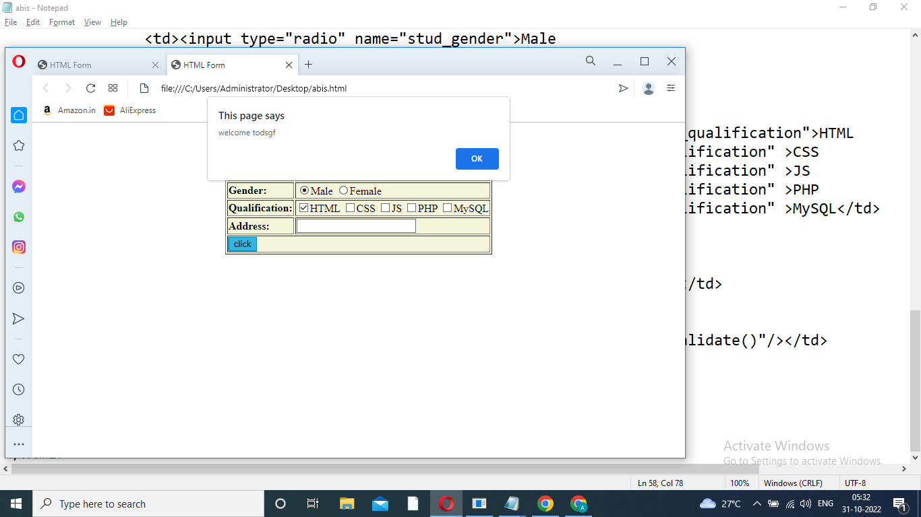
Display Output

Slide 8

Display Output

